Slide 1


Vibration Analysis of Tapered Truncated cantilever beams using Deep Learning
Naman Yadav
Asim Tewari
Department of Mechanical Engineering, IIT Bombay
IMEC 2019

Slide 2
Overview
Motivation
Deep Learning Model
Data Generation
Model Training
Training parameters and results
Percent deviations of predicted values
Graphical comparison with actual values
Extrapolation Analysis
Prediction ability over unseen data range
Conclusion
Future Research

Slide 3
Overview
Motivation

Slide 4
motivation
Some problems are really difficult or impossible to solve theoretically.
In some cases these can be solved by fitting curve to some data-points generated for special cases.
Data driven approach:
Removes necessity of field specific knowledge.
There is a large amount of data present.
Highly optimized algorithms are there to process this data.
Tremendous computational power available.

Slide 5
Overview
Motivation
Deep Learning Model

Slide 6

Deep Learning Model
Training data was generated using MATLAB.
Neural network features:
Activation function: PReLU
Loss function: Mean squared percent error
Optimizer: Adam optimizer
Training of Neural network was done on Python using PyTorch.

Slide 7

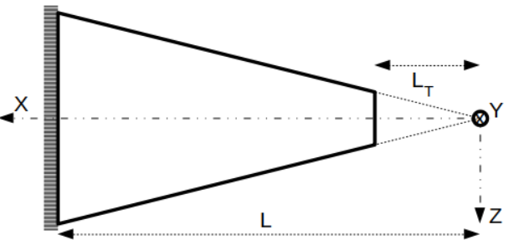

Input Variables
Variation in cross-sectional properties:
$$A=A_{C}δ^{η}$$
$$I=I_{C}δ^{η+2}$$
(where, $δ=\frac{x}{L}, δ ϵ \left[δ0,1\right] and η \text{is} \text{a} \text{non}\text{−}\text{negative} \text{real} \text{number}$)
$η and δ0$ are inputs to the neural network.

Slide 8
Neural network Architecture
Input Layer
(2 units)
Hidden Layer
(without activation)
(6*N2 units)
Hidden Layers
(with activation and normalisation)
(L1 layers and N1 units in each layer)
Output Layer
(6 units)
Hidden Layer
(without activation)
(6*N2 units)

Slide 9
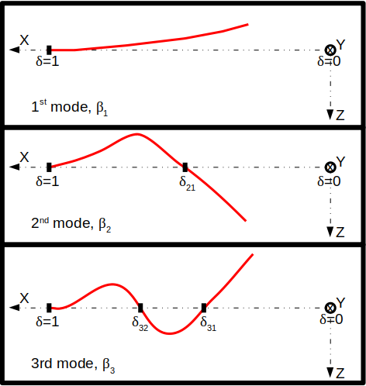
Output variables
Output variables
β₁, β₂, β₃, δ₂₁, δ₃₁, δ₃₂ (6 variables)
β₁, β₂, β₃ are the natural frequency parameters
δ₂₁, δ₃₁, δ₃₂ are the node locations

Slide 10

Actual Variation of Output Variables
Euler-Bernoulli equation
$$\frac{∂^{2}}{∂x^{2}}\left(EI\left(x\right)\frac{∂^{2}y\left(x,t\right)}{∂x^{2}}\right)+ρA\left(x\right)\frac{∂^{2}y\left(x,t\right)}{∂t^{2}}=0$$
Using variable separation
$$y\left(x,t\right)=W\left(x\right)e^{iωt}$$
General solution of $W\left(x\right)$
$$W\left(δ\right)={\left(Lδ\right)}^{{−η}/2}\left[c_{1}J_{η}\left(z\right)+c_{2}Y_{η}\left(z\right)+c_{3}I_{η}\left(z\right)+c_{4}K_{η}\left(z\right)\right]$$
where, $z=2βδ^{1/2}$, $β=ω^{2}L^{4}\left(\frac{ρA_{C}}{{EI}_{C}}\right)$, $δ=\frac{x}{L}$
J_{η} and Y_{η} are η^{th} order Bessel Functions of first and second kind, respectively.
I_{η} and K_{η} are modified η^{th} order Bessel Function of first and second kind, respectively.
Boundary conditions
$$\frac{∂}{∂δ}\left(EI\left(δ\right)\frac{∂^{2}W\left(δ\right)}{∂δ^{2}}\right)=\frac{∂^{2}W\left(δ\right)}{∂δ^{2}}=0,atδ=δ_{0}$$
$$W\left(δ\right)=\frac{∂W\left(δ\right)}{∂δ}=0,atδ=δ_{1}=1$$

Slide 11

Actual Variation of Output Variables
After applying boundary conditions we will get 4 linear equations:
$$Δ=\left|\begin{matrix}J_{η+1}\left(z_{0}\right) & Y_{η+1}\left(z_{0}\right) & I_{η+1}\left(z_{0}\right) & −K_{η+1}\left(z_{0}\right) \\ J_{η+2}\left(z_{0}\right) & Y_{η+2}\left(z_{0}\right) & I_{η+2}\left(z_{0}\right) & K_{η+2}\left(z_{0}\right) \\ J_{η}\left(z_{1}\right) & Y_{η}\left(z_{1}\right) & I_{η}\left(z_{1}\right) & K_{η}\left(z_{1}\right) \\ J_{η+1}\left(z_{1}\right) & Y_{η+1}\left(z_{1}\right) & −I_{η+1}\left(z_{1}\right) & K_{η+1}\left(z_{1}\right)\end{matrix}\right|=0$$
After solving Δ = 0, we can get values of β = β_{r}, where, r is the mode number. From which, we can compute $ω_{r}$ and $z_{r}$ using following relations,
$ω_{r}={\left(\frac{β_{r}}{L}\right)}^{2}\sqrt{\frac{{EI}_{C}}{ρA_{C}}}$, $z_{r}=2β_{r}δ^{1/2}$
Finally, mode shapes can be obtained as follows,
$$W\left(δ\right)={\left(Lδ\right)}^{{−η}/2}\left[c_{1}J_{η}\left(z_{r}\right)+c_{2}Y_{η}\left(z_{r}\right)+c_{3}I_{η}\left(z_{r}\right)+c_{4}K_{η}\left(z_{r}\right)\right]$$

Slide 12
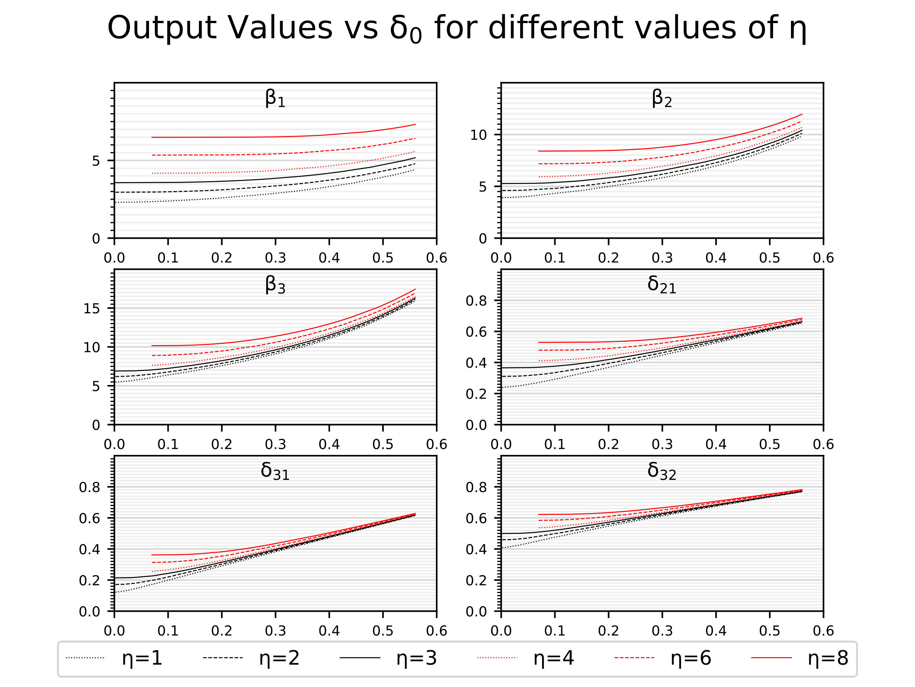
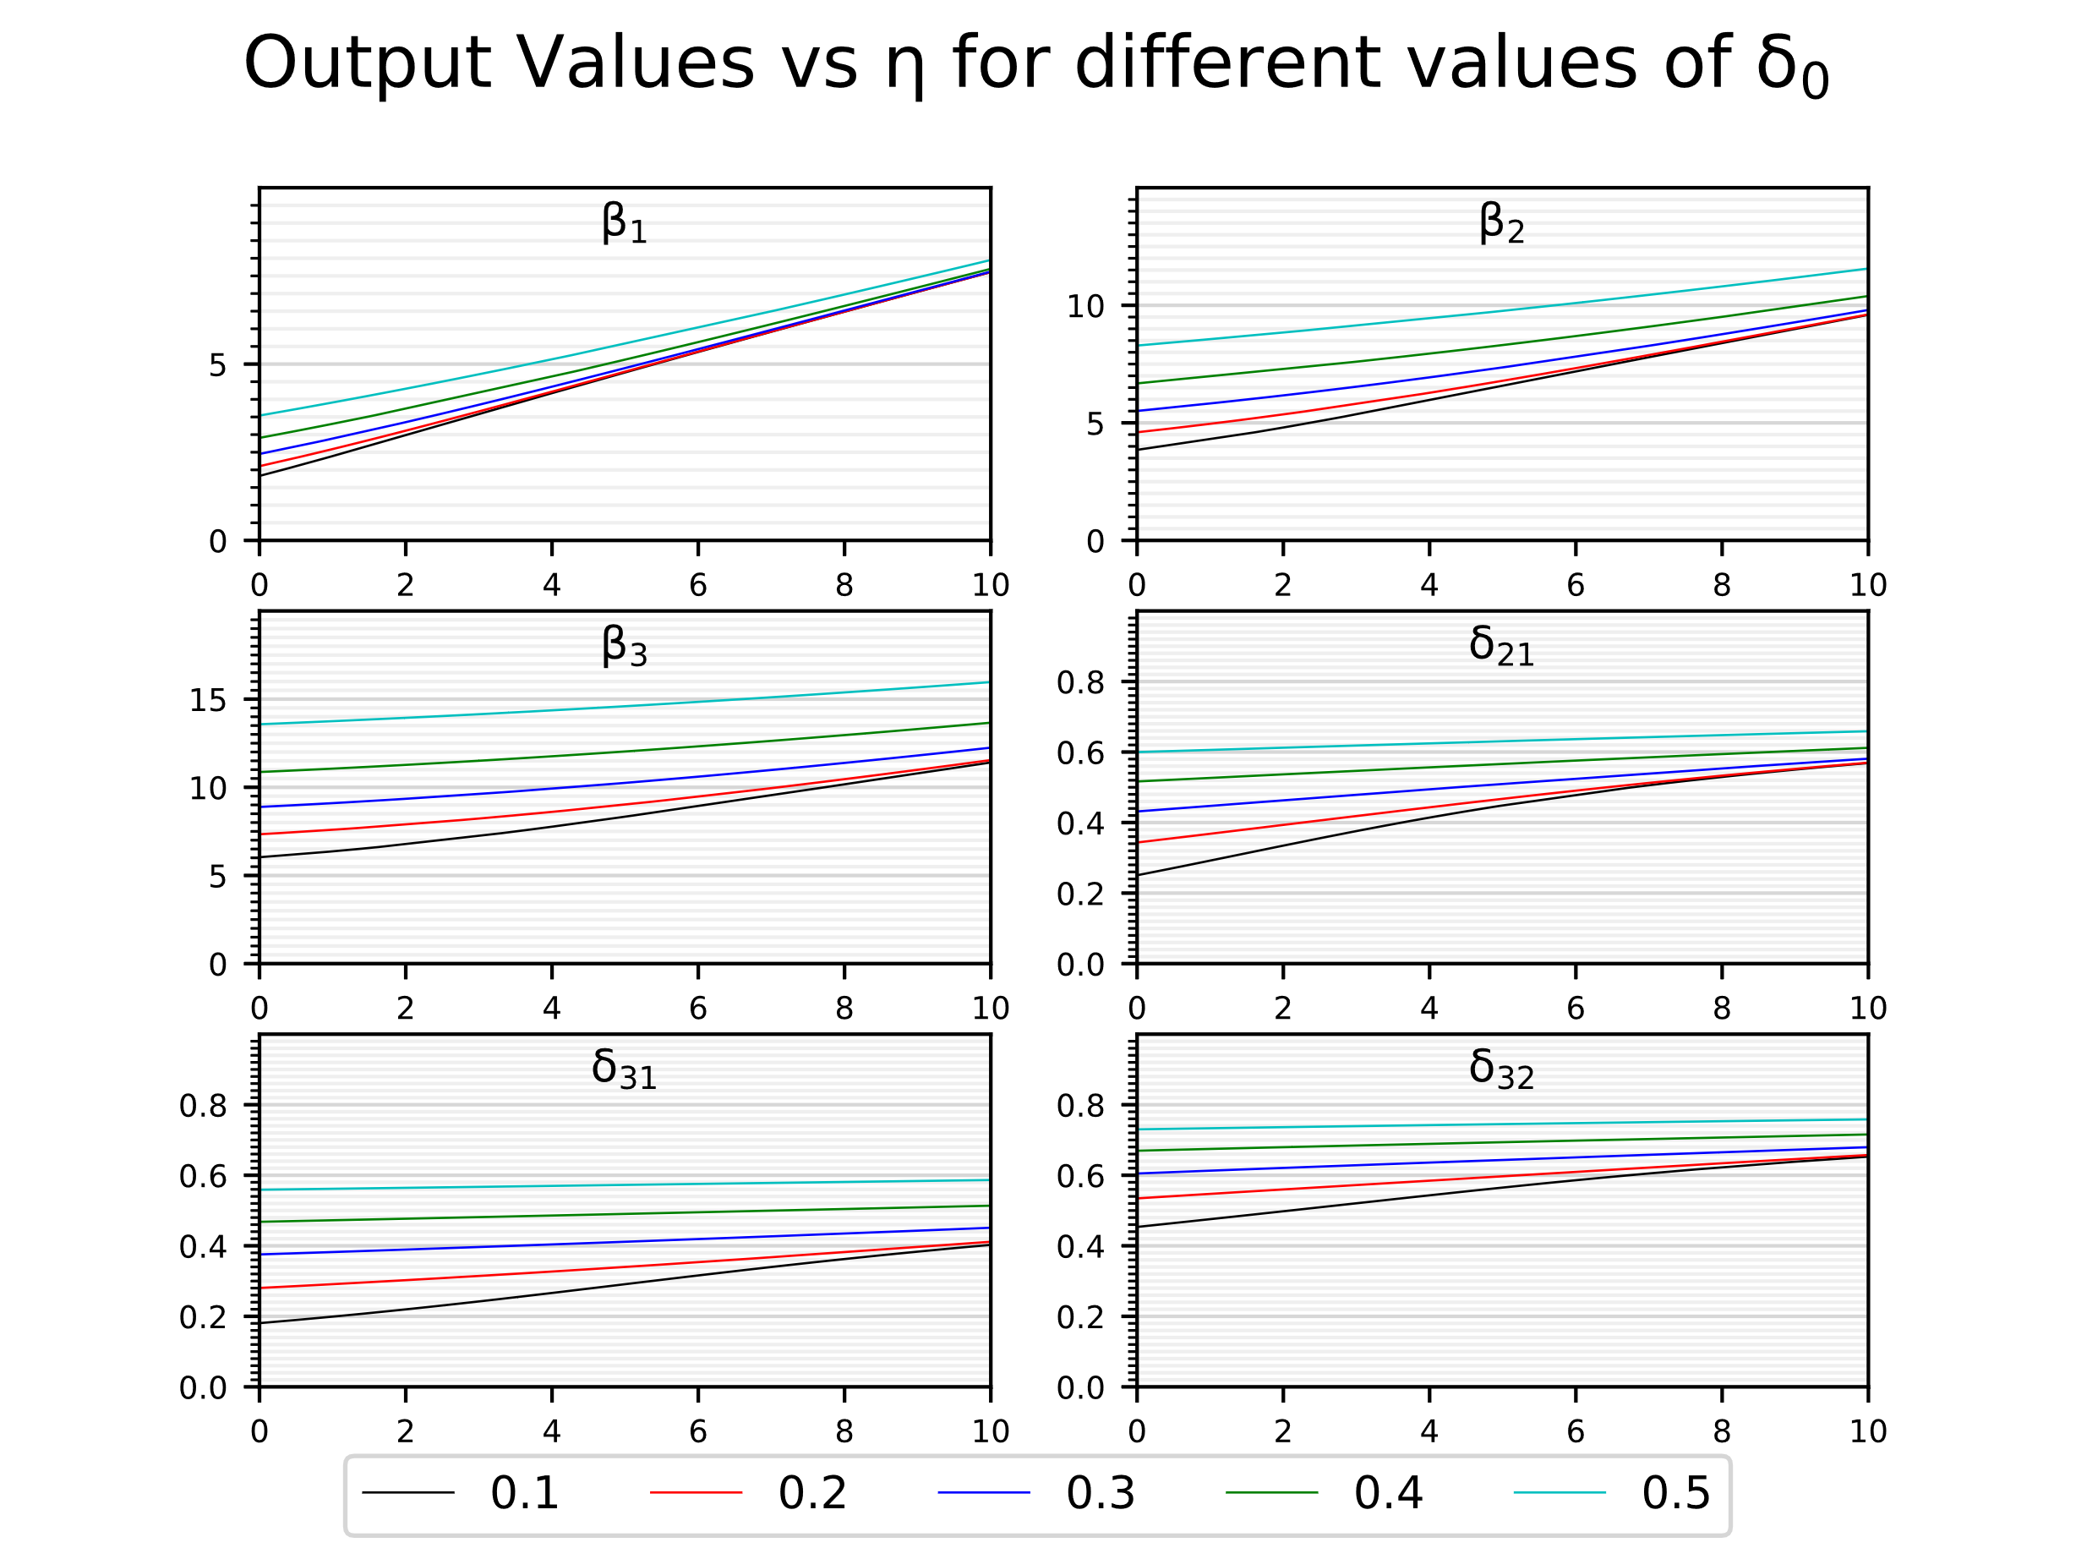
Actual Variation of Output Variables

Slide 13
Overview
Motivation
Deep Learning Model
Data Generation

Slide 14
Data Generation
η є [0, 3], δ₀ є [2e-3, 0.56] => 301*15,000 datapoints.
η є [3, 10], δ₀ є [7e-2, 0.56] => 701*15,000 datapoints.
For η є [0, 10], data from the two cases was merged:
η є [0, 3], δ₀ є [2e-3, 0.56] => 301*15,000 = 4,515,000.
η є (3, 10], δ₀ є [7e-2, 0.56] => 700*15,000 = 10,500,000.
In total 15,015,000 datapoints were generated.
But only a fraction was used for training.

Slide 15
Overview
Motivation
Deep Learning Model
Data Generation
Model Training

Slide 16

Model Training
Training and validation data
Generated data was shuffled.
Few data points were sampled from shuffled data to train the neural network.
Some datapoints for validation were also selected.
Test data
A separate data set was created by randomly sampling points.
Results
Trained model was evaluated over the unseen test dataset to report the results.

Slide 17
Overview
Motivation
Deep Learning Model
Data Generation
Model Training
Training parameters and results

Slide 18
Training Parameters
Table 1: Deep Learning model training parameters
 | SD (Small Dataset) | BD (Big Dataset)
# Training datapoints | 2*2¹¹ | 20*2¹¹
# Validation datapoints | 1,000
# Iterations | 30,000
Initial Learning Rate | 0.01
Update period | 5,000
Update factor | 5

Slide 19

Training Results
 | SD (Small Dataset) | BD (Big Dataset)
# Training datapoints | 2*2¹¹ | 20*2¹¹
L1 | 3 | 7
N1 | 173 | 207
N2 | 3 | 3
SN (Small Network)
BN (Big Network)

Slide 20
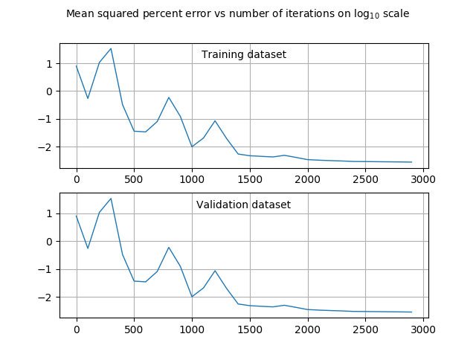
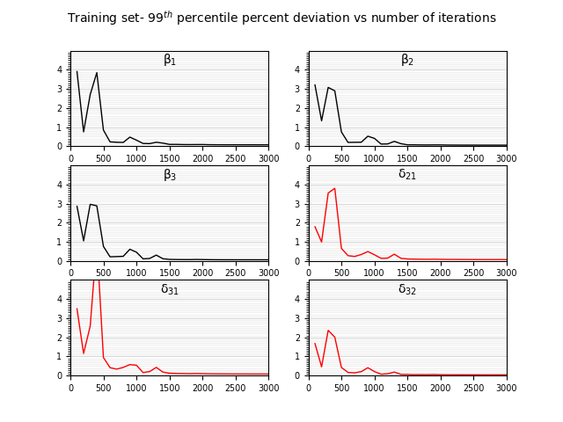
Training Results

Slide 21
Overview
Motivation
Deep Learning Model
Data Generation
Model Training
Training parameters and results
Percent deviations of predicted values

Slide 22
Percent Deviations
Table 2: For η є [0, 3], δ₀ є [2e-3, 0.56]
Output | Mean Percent dev. |  | Max. Percent dev.
 | SD-SN | BD-BN | SD-SN | BD-BN
β₁ | 0.022 | 0.011 | 0.115 | 0.106
β₂ | 0.020 | 0.008 | 0.110 | 0.071
β₃ | 0.021 | 0.009 | 0.111 | 0.052
δ₂₁ | 0.016 | 0.012 | 0.172 | 0.101
δ₃₁ | 0.024 | 0.013 | 0.317 | 0.255
δ₃₂ | 0.012 | 0.007 | 0.159 | 0.083
Table 3: For η є [3, 10], δ₀ є [7e-2, 0.56]
Output | Mean Percent dev. |  | Max. Percent dev.
 | SD-SN | BD-BN | SD-SN | BD-BN
β₁ | 0.019 | 0.011 | 0.130 | 0.079
β₂ | 0.018 | 0.010 | 0.130 | 0.046
β₃ | 0.019 | 0.010 | 0.123 | 0.054
δ₂₁ | 0.013 | 0.009 | 0.090 | 0.050
δ₃₁ | 0.019 | 0.009 | 0.169 | 0.051
δ₃₂ | 0.010 | 0.005 | 0.055 | 0.037

Slide 23
Overview
Motivation
Deep Learning Model
Data Generation
Model Training
Training parameters and results
Percent deviations of predicted values
Graphical comparison with actual values

Slide 24
Comparison Between Actual And Predicted Values

Slide 25
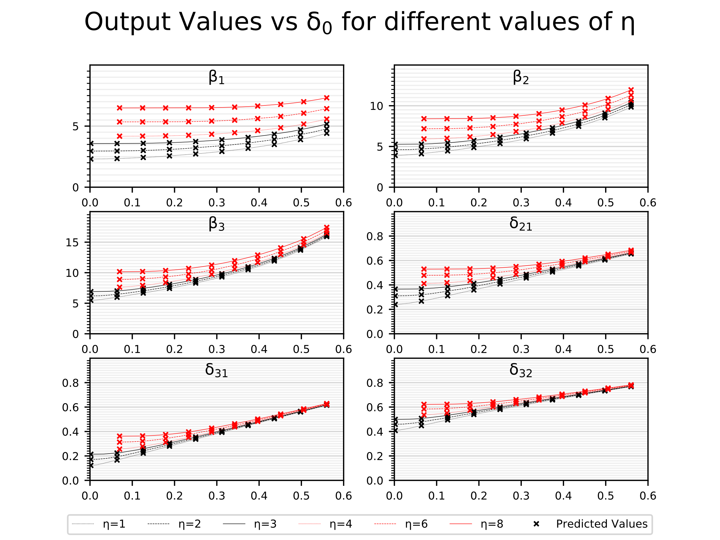
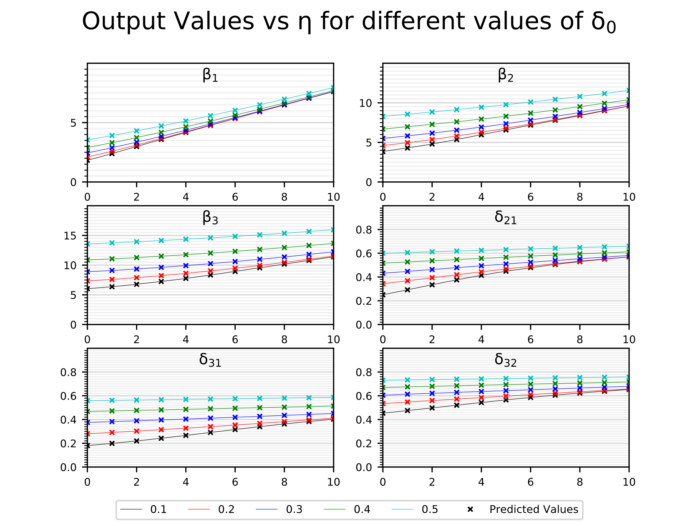
Comparison Between Actual And Predicted Values

Slide 26
Overview
Motivation
Deep Learning Model
Data Generation
Model Training
Training parameters and results
Percent deviations of predicted values
Graphical comparison with actual values
Extrapolation Analysis

Slide 27
Extrapolation Analysis
Data was then split back into two parts as generated:
Part 1: η є [0, 3], δ₀ є [2e-3, 0.56]
Part 2: η є [3, 10], δ₀ є [7e-2, 0.56]
Models corresponding to SD and BD mentioned earlier were trained on one part and then evaluated on the other to see its extrapolation capabilities.

Slide 28
Overview
Motivation
Deep Learning Model
Data Generation
Model Training
Training parameters and results
Percent deviations of predicted values
Graphical comparison with actual values
Extrapolation Analysis
Prediction ability over unseen data range

Slide 29
Trained On Part 1 Evaluated over Part 2
Table 4: Trained over η є [0, 3] and evaluated over η є [3, 10]
Output | Mean Percent dev. |  | Max. Percent dev.
 | SD-SN | BD-BN | SD-SN | BD-BN
β₁ | 12.922 | 19.327 | 26.671 | 40.068
β₂ | 7.082 | 12.582 | 19.416 | 31.156
β₃ | 3.737 | 8.609 | 13.828 | 23.150
δ₂₁ | 1.866 | 8.318 | 7.643 | 21.166
δ₃₁ | 2.919 | 7.453 | 7.816 | 20.621
δ₃₂ | 1.331 | 4.310 | 3.593 | 11.100

Slide 30
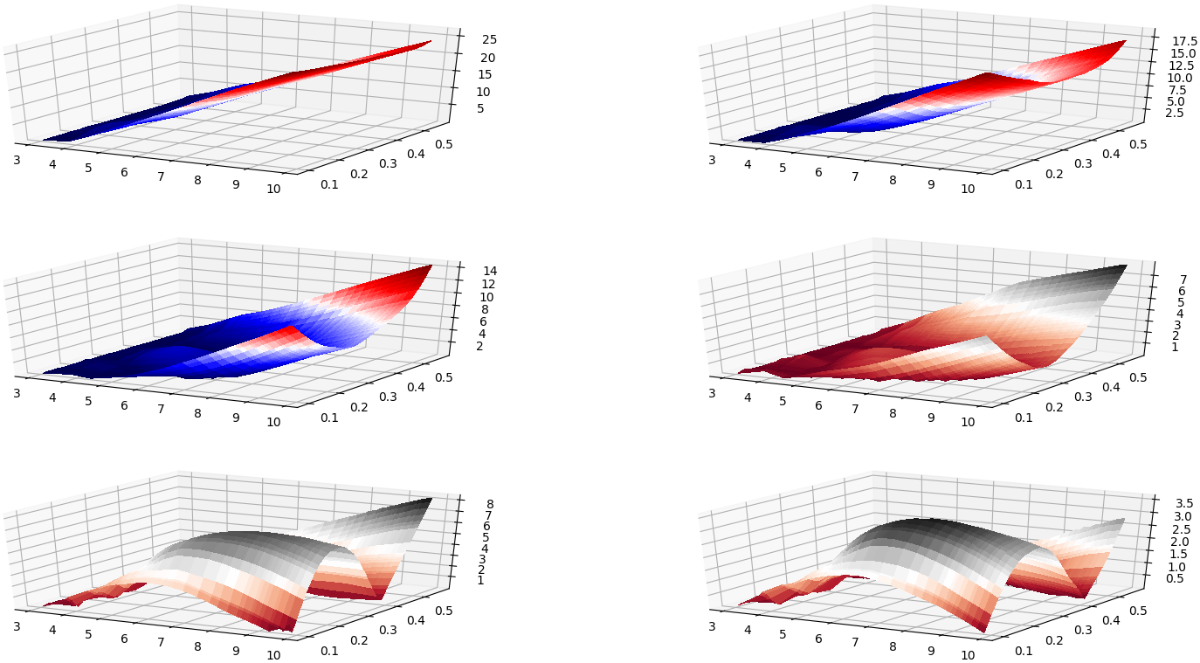
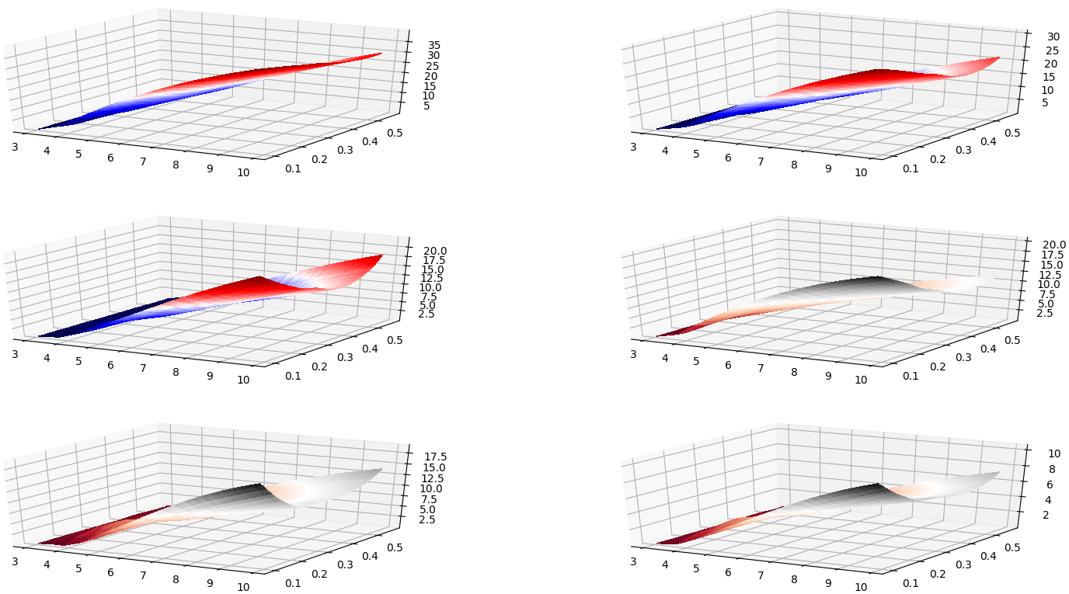
Percent Deviation Variation
SD-SN
N1 – 3
L1 – 173
N2 - 3
BD-BN
N1 – 7
L1 – 207
N2 - 3

Slide 31
Trained On Part 2 Evaluated over Part 1
Table 5: Trained over η є [3, 10] and evaluated over η є [0, 3]
Output | Mean Percent dev. |  | Max. Percent dev.
 | SD-SN | BD-BN | SD-SN | BD-BN
β₁ | 10.620 | 4.630 | 94.813 | 57.242
β₂ | 6.181 | 1.808 | 58.538 | 19.544
β₃ | 4.826 | 1.361 | 45.678 | 10.128
δ₂₁ | 7.060 | 3.664 | 121.945 | 80.435
δ₃₁ | 9.475 | 4.975 | 202.181 | 134.401
δ₃₂ | 3.174 | 1.408 | 43.375 | 27.963

Slide 32
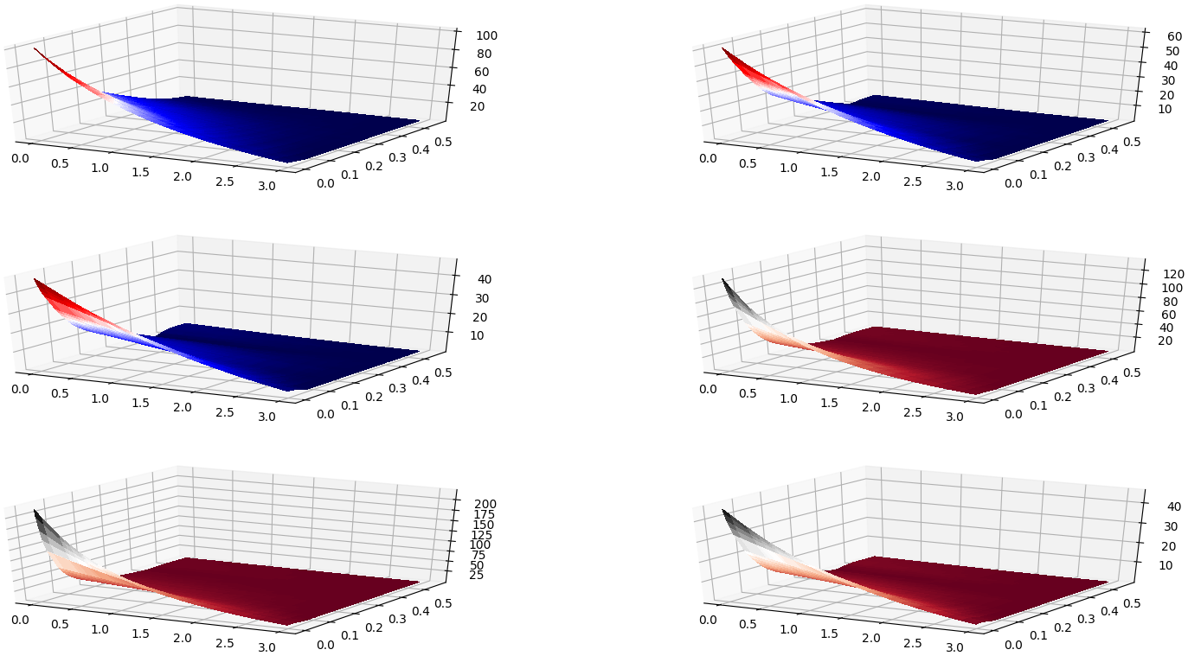
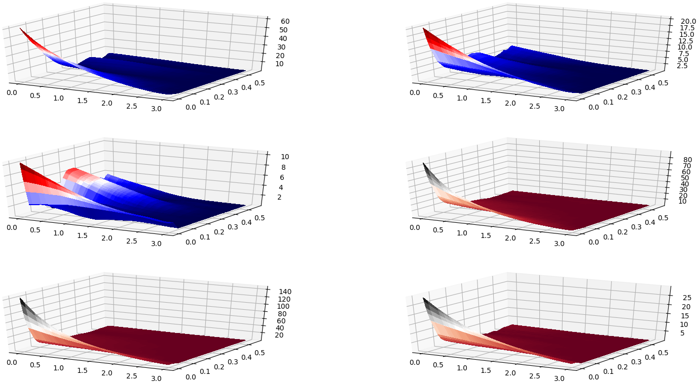
Percent Deviation Variation
SD-Sn
N1 – 3
L1 – 173
N2 - 3
BD-BN
N1 – 7
L1 – 207
N2 - 3

Slide 33
Overview
Motivation
Deep Learning Model
Data Generation
Model Training
Training parameters and results
Percent deviations of predicted values
Graphical comparison with actual values
Extrapolation Analysis
Prediction ability over unseen data range
Conclusion

Slide 34
Conclusion
 | Small Neural Network | Large Neural Network
Simple trend in Training Data compared to evaluation data | Not Recommended | Recommended
Complex trend in Training Data compared to evaluation data | Recommended | Not Recommended

Slide 35
Overview
Motivation
Deep Learning Model
Data Generation
Model Training
Training parameters and results
Percent deviations of predicted values
Graphical comparison with actual values
Extrapolation Analysis
Prediction ability over unseen data range
Conclusion
Future Research

Slide 36

Future Research
These models can also be trained on data for beams subjected to other boundary conditions.
Due to similar underlying equations, we can expect reasonably high accuracy in predictions.
Other better models could be developed to improve the extrapolation accuracy of the neural network far away from trained range.
Challenging part in doing this is the complex nature of Bessel functions, which contain integrations of factorial, factorials in denominator, etc.

Slide 37
Thank You
Questions ?

